Slide 1
YouTube Trending Videos Analysis
BU-MSSP
Yifeng Luo

Slide 2
Introduction
Benford’s Law for Views
Top Views Video
Views Movement
Correlation of Numeric Variable
Video Category
Time Gap
Top Channels
Text Mining for Tags
Text Mining for Description
Sentiment Analysis of Description

Slide 3
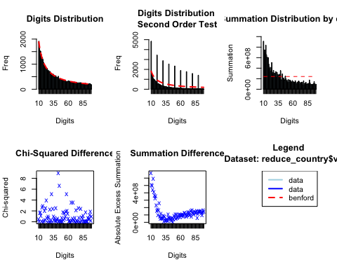
Benford’s Law for Video Views
Chi-square Test:
P-value=0.17 → Fail to reject H0

Slide 4
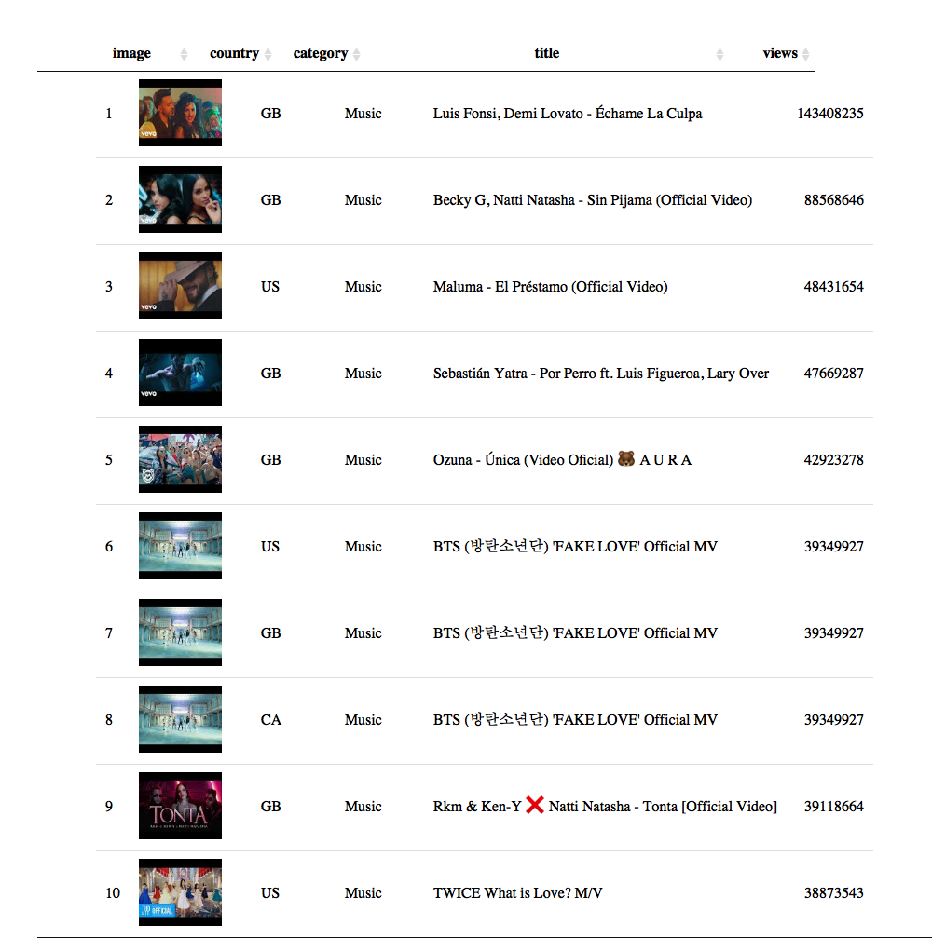
Top 10 Views of Trending Videos

Slide 5
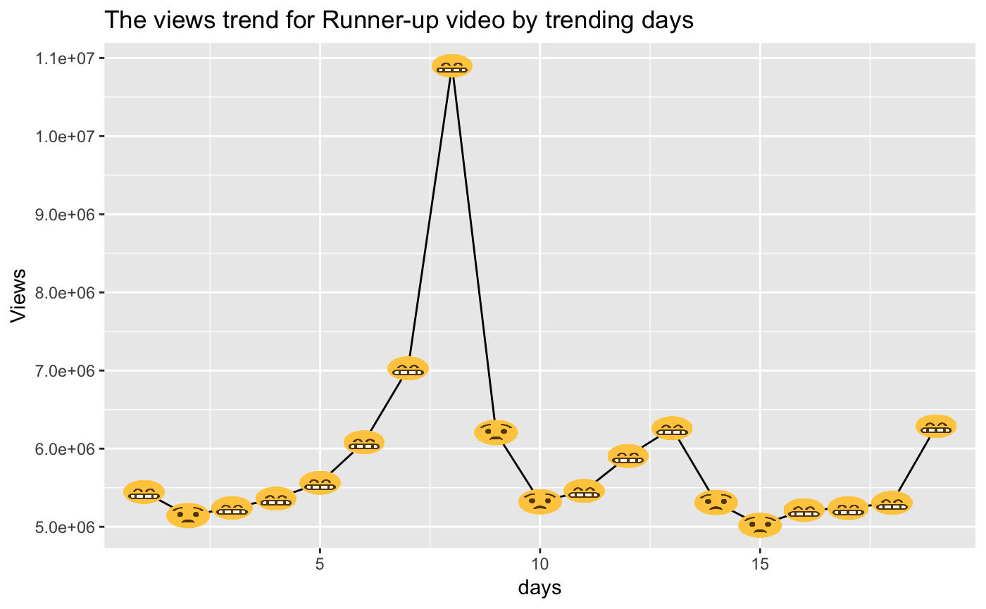
The Movement of Views Increment by Trending Days
😬= Increase
😟= Decrease

Slide 6
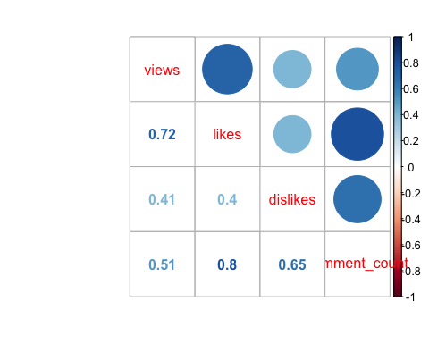
The Correlation of Amount of View, Like, Dislike and Comment
Highly positive correlation

Slide 7
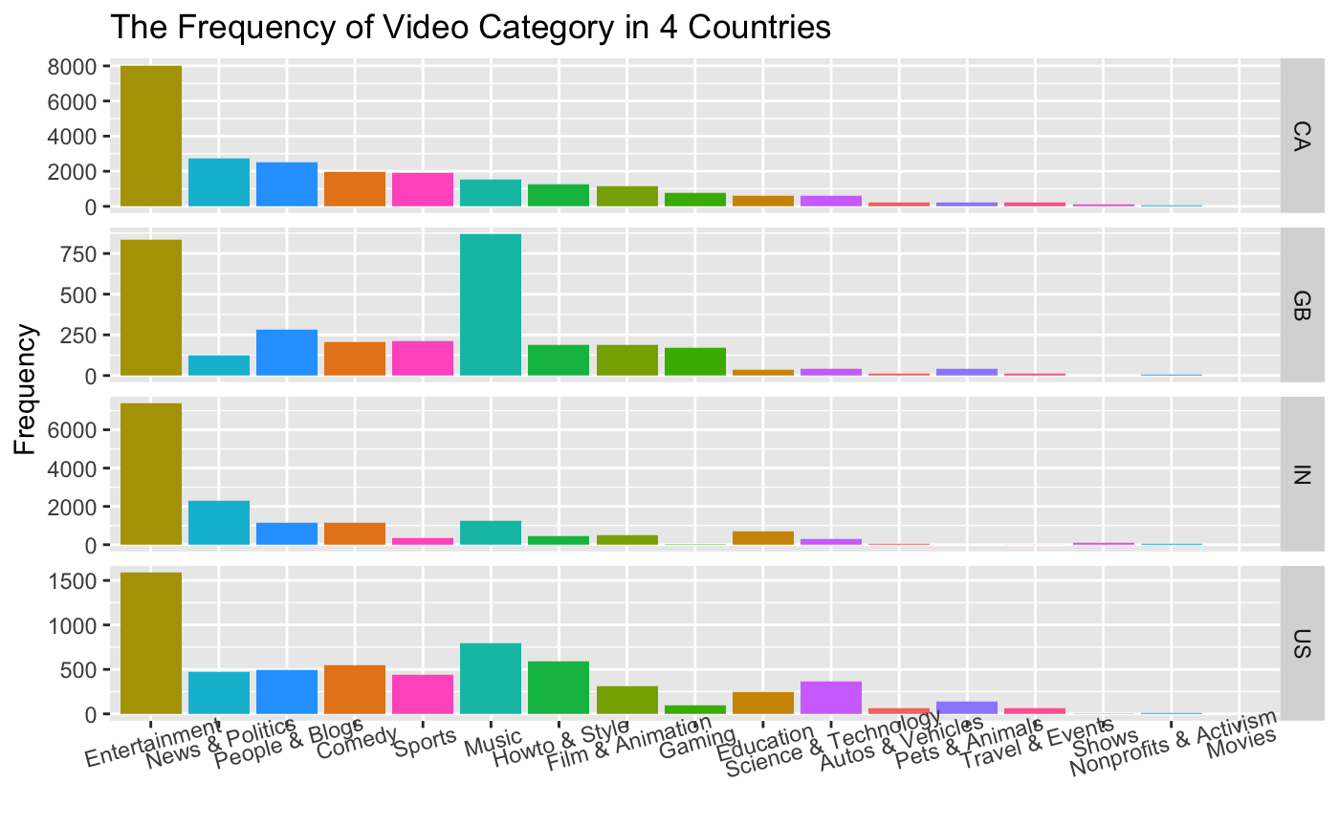
The Difference of the Frequency of Video Category among Countries
Entertainment, Music, News & Politics…

Slide 8
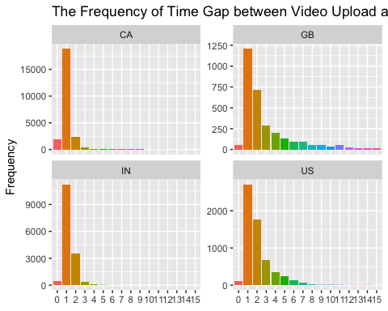
The Distribution of Time Gap between Video Uploading and Trending
1-3 days after video uploading

Slide 9
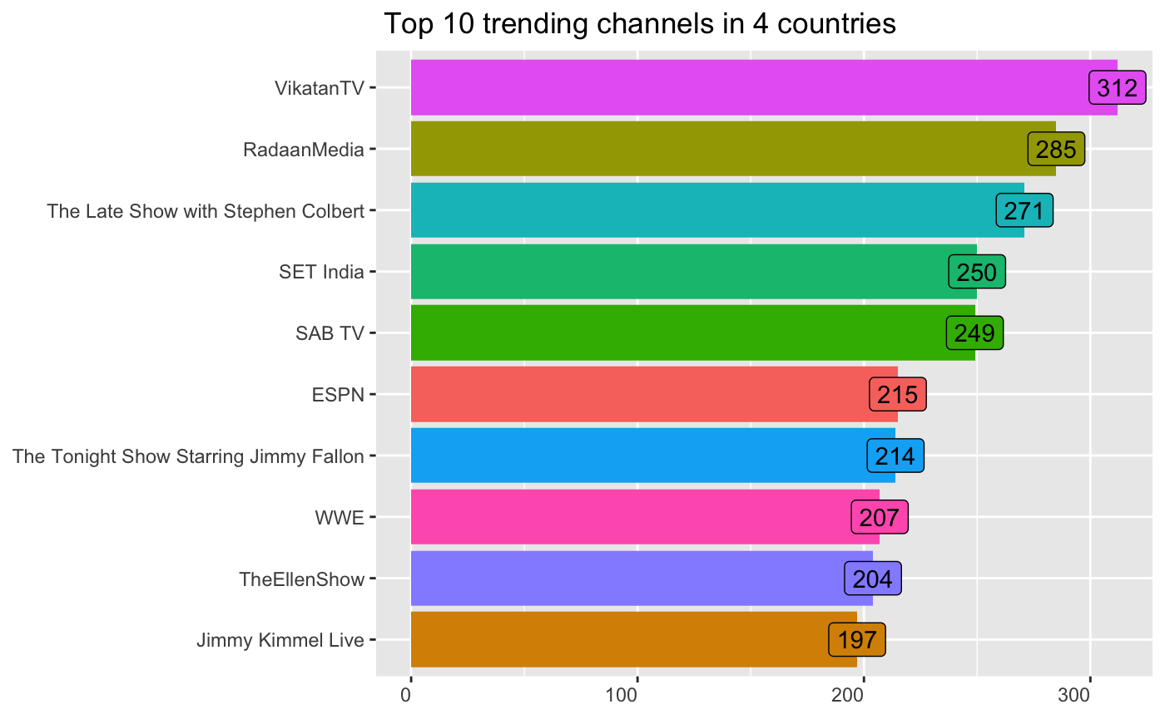
Top 10 Trending Channels in 4 Countries
TV Channel and Talk Show are very popular

Slide 10
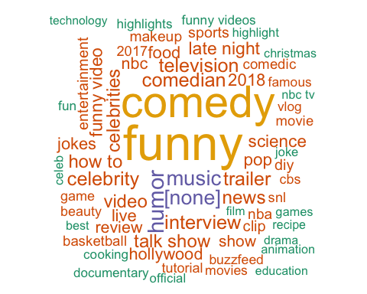
US-Tags ‘comedy’ ‘funny’ ‘hollywood’ ‘nba’

Slide 11
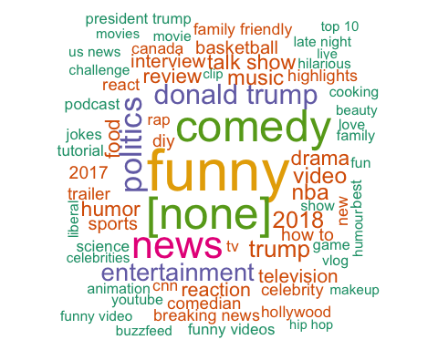
CA-Tags ‘donald trump’ ‘trump’ ‘[none]’ ‘politics’

Slide 12
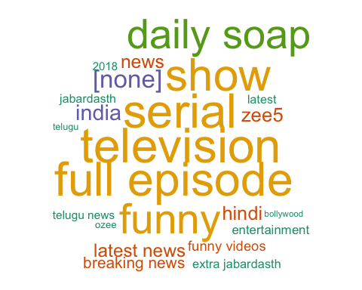
IN-Tags ‘full episode’ ‘daily soap’ ‘hindi’ ‘bollywood’

Slide 13
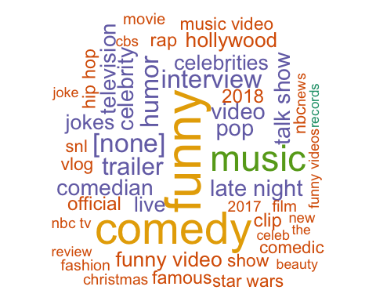
UK-Tags ‘music’ ‘pop’ ‘trailer’ ‘rap’

Slide 14
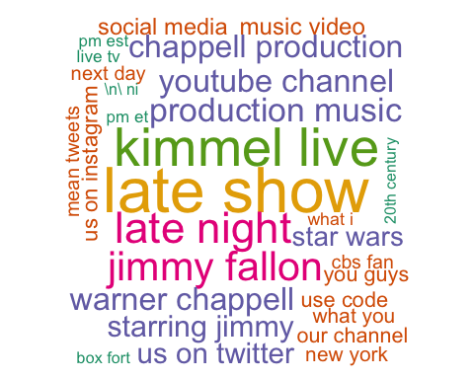
US-Description ‘kimmel live’ ‘jimmy fallon’ ‘warner chappell’ ‘production music’

Slide 15
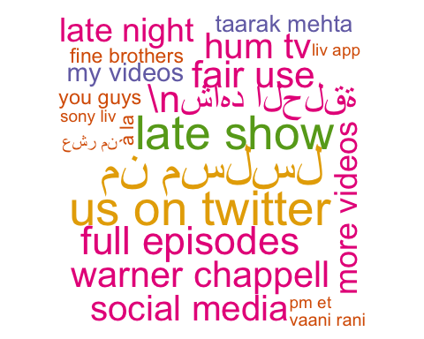
CA-Description ‘warner chappell’ ‘late show’ ‘social media’ other language

Slide 16
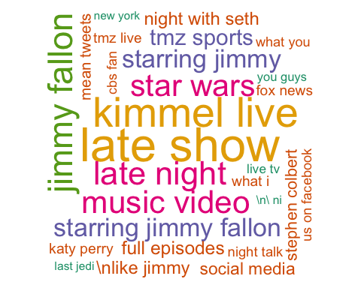
UK-Description ’jimmy fallon’ ‘kimmel live’ ‘music video’ ‘star wars’

Slide 17
IN-Description ’full episode’ ‘current affairs’ ‘ozee app’

Slide 18
Negative vs. Positive in Description
Positive > Negative

Slide 19
The Distribution of Sentiment Score of Description by Countries
Score > 0 → Positive

Slide 20
The End
QUESTIONS & COMMENTS

